Slide 1
Predicting Automobile Prices Using Neural Networks BANL 6900 Business Analytics Capstone
Divya Chopparapu
Himabindhu Karnati
Karthik Nayakam
Venkatesh Adusuru

Slide 2
Agenda
Business Problem
Project Overview
Literature Review
Data Description
Data Preparation
Modeling Approach
Model Performance Summary
Key Findings from R Analysis
Dashboard Insights
Recommendations
Conclusion
References

Slide 3
Business Problem
Key Business Questions?
Which vehicle characteristics most strongly influence used-car prices?
Why This Matters?
Supports accurate pricing decisions for manufacturers & dealers
Which predictive modeling technique provides the most reliable pricing results?
Improves forecasting for revenue planning
Enhances inventory management for competitive advantage

Slide 4
Project Overview
Dataset
1,367 used-car records, 28 original features
Methods applied
Linear Regression, Decision Tree, Neural Network
Tools used
R, R Markdown, Power BI
Goal
Identify key predictors and evaluate model performance

Slide 5
Literature Review
Age, mileage, and engine characteristics consistently identified as primary drivers of used-car pricing. (Zhang & Wang, 2020).
Machine learning models improve pricing precision in dynamic automobile markets. (Kabir et al., 2019).
Neural networks capture nonlinear relationships but require larger datasets for stable performance. (Karlaftis & Vlahogianni, 2011).

Slide 6
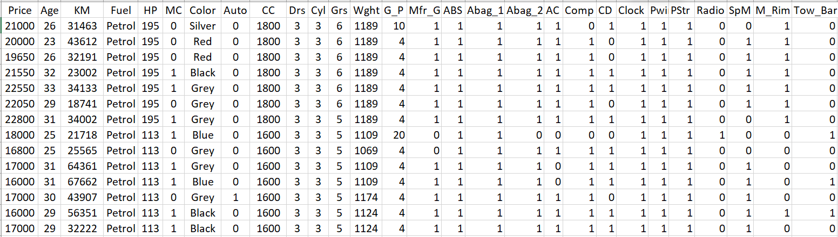
Data Description
Numerical Variables
Price, Age, KM (mileage), HP (horsepower), Weight
Categorical Variables
Fuel type, Color
Binary Variables
ABS, Airbags, AC, Radio, Tow Bar, Power Steering, Power Windows
Final Dataset
Cleaned and prepared dataset with 36 encoded variables

Slide 7
Data Preparation
Converted categorical fields into factors
Created dummy variables for Fuel and Color
Normalized predictors for neural network stability
Checked for missing or inconsistent key variables
Split data into 70% training and 30% validation

Slide 8
Modeling Approach
Predictive Modeling Framework
Supervised learning techniques
Models Used
Linear Regression
Decision Tree
Training & Validation Split
70% Training
30% Validation
Neural Network
Models compared
Root Mean Squared Error (RMSE)
Mean Absolute Error (MAE)
Coefficient of Determination (R²)

Slide 9
Model Performance Summary
Linear Regression
RMSE: 1167.97
MAE: 908.23
R²: 0.900
Decision Tree
RMSE: 1409.78
Neural Network
RMSE: 3686.85
MAE: 1024.64
R²: 0.854
MAE: 2563.66
R²: Unstable

Slide 10
Key Findings from R Analysis
Age and mileage are the strongest negative predictors of price.
Horsepower, manufacturing group, and features like AC and ABS increase price.
Linear Regression achieved the most reliable and stable performance.
Neural networks underperformed due to dataset size and feature sparsity.

Slide 11
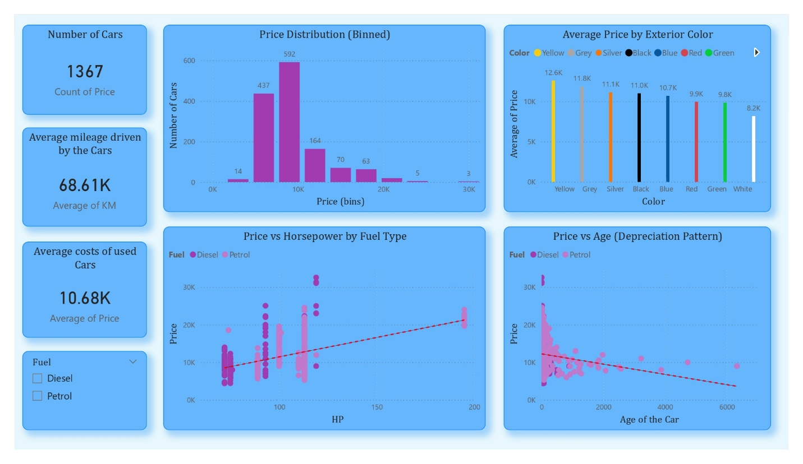
Dashboard Insights (Page 1: pRICE Overview)
Average Mileage (68K km) and Average Price (~$10.7K) provide a baseline for the dataset.
Price Distribution: Most used cars fall within the $8K–$12K range.
Average Price by Exterior Color: Yellow, grey, and silver tend to achieve higher average prices, while white and green are lower.
Price vs Horsepower by Fuel: Petrol and diesel categories show similar positive slopes, but diesel cars cluster slightly higher in price.
Price vs Age: A clear depreciation curve confirms that price declines steadily as vehicle age increases.
Insight: Age, mileage, horsepower, and color are the primary price differentiators.

Slide 12
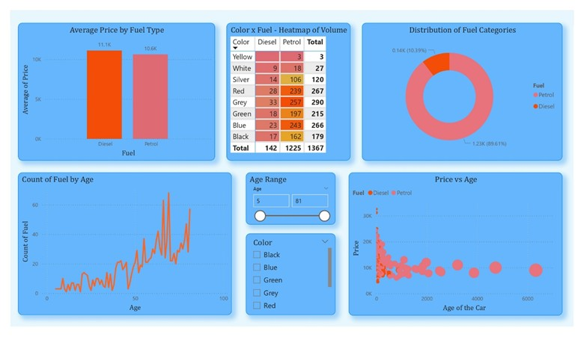
Dashboard Insights (Page 2: Fuel & Color Segments)
Average Price by Fuel: Diesel vehicles show slightly higher average prices than petrol cars.
Color × Fuel Heatmap: Grey, blue, and red are the most common; silver is less frequent but mid-priced.
Distribution of Fuel Categories: Dataset is ~90% petrol, with diesel representing a smaller share.
Fuel Count by Age: Fuel type distribution remains consistent across age, indicating no sampling bias.
Price vs Age by Fuel: Both fuels depreciate similarly; some diesel vehicles retain value slightly better.
Insight: Fuel and color matter, but age and mileage remain dominant predictors.

Slide 13
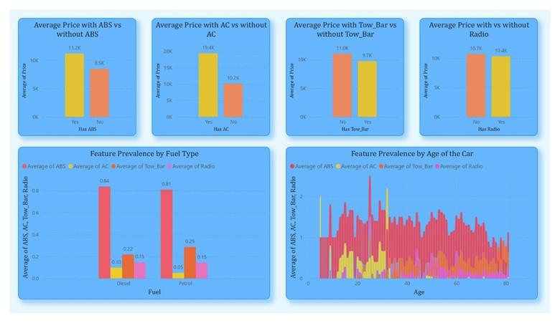
Dashboard Insights (Page 3: Equipment & Features)
ABS, AC, Tow Bar, Radio: Vehicles with these features consistently have higher average prices.
Feature Prevalence by Fuel: Diesel vehicles show higher presence of key features like ABS and AC; radio rates similar across fuels.
Feature Prevalence by Age: Newer cars include more modern features; ABS is consistently present across all ages.
Insight: Equipment significantly contributes to pricing - aligning with regression findings.

Slide 14
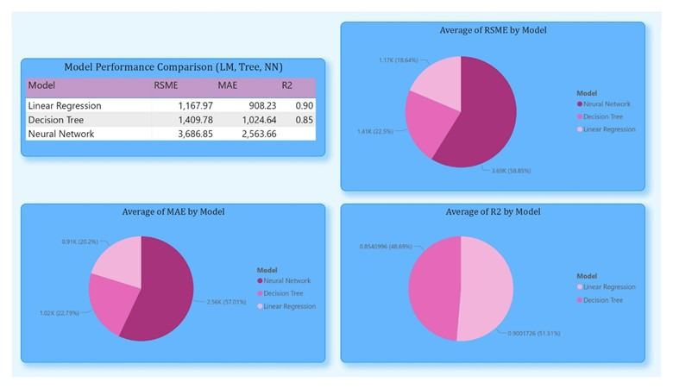
Dashboard Insights (Page 4: Model Summary & Comparison)
Linear Regression: RMSE = 1,168; MAE = 908; R² = 0.90
Decision Tree: RMSE = 1,410; MAE = 1,024; R² = 0.85
Neural Network: RMSE = 3,687; MAE = 2,563; R² unstable
Summary: Linear Regression delivers the most accurate and reliable predictions, outperforming both decision-tree and neural-network-based models.
Insight: Provides direct response to business question - linear regression is the best model for this dataset.

Slide 15
Final Recommendations
Use Linear Regression as the primary pricing model
Use Decision Trees for interpretability and business rule development
Avoid Neural Networks unless more data is collected
Maintain an analytics dashboard for ongoing monitoring
Retrain the model periodically as market conditions change

Slide 16
Conclusion
Age, and mileage remain the strongest predictors of used-car prices
Feature availability contributes to price differences, especially in newer vehicles.
Linear Regression produced the most accurate predictions
Dashboards validated strong depreciation patterns and feature impacts
Future research: incorporate brand effects, service records, regional pricing trends, economic indicators

Slide 17
REFERENCES
[1] Kabir, M., Satu, M. S., & Amin, M. R. (2019). Used car price prediction using machine learning techniques. International Journal of Advanced Computer Science and Applications, 10(8), 451–459.
[2] Karlaftis, M. G., & Vlahogianni, E. I. (2011). Statistical methods versus neural networks in transportation research: Differences, similarities and some insights. Transportation Research Part C: Emerging Technologies, 19(3), 387–399.
[3] Zhang, X., & Wang, K. (2020). Determinants of used-car prices in online marketplaces: A machine-learning approach. Journal of Retailing and Consumer Services, 54, 102029.

Slide 18
THANK YOU
FOR YOUR ATTENTION

